Slide 1


Slide 2
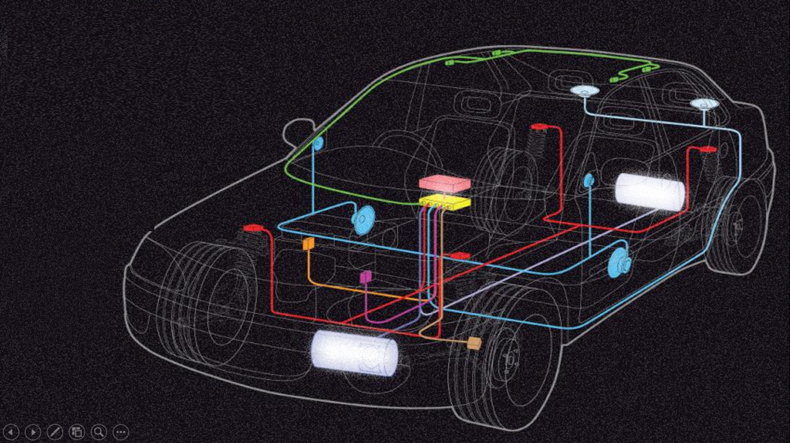
Performance Comparison of different Noise Cancellation Algorithms
Project Supervisors
Prof. S Siva Sankara Sai
SSSIHL
Sri Sivaramakrishnan S
Analog Devices India
Project Mentor
T.S.S. Babu
Analog Devices India
R Ramakrishna Chaitanya
II M.TECH(OEC)
Regd No:17706

Slide 3
Contents
Importance of Noise Cancellation
Terminology in Active Noise Cancellation
Noise Cancellation
Results and discussions

Slide 4
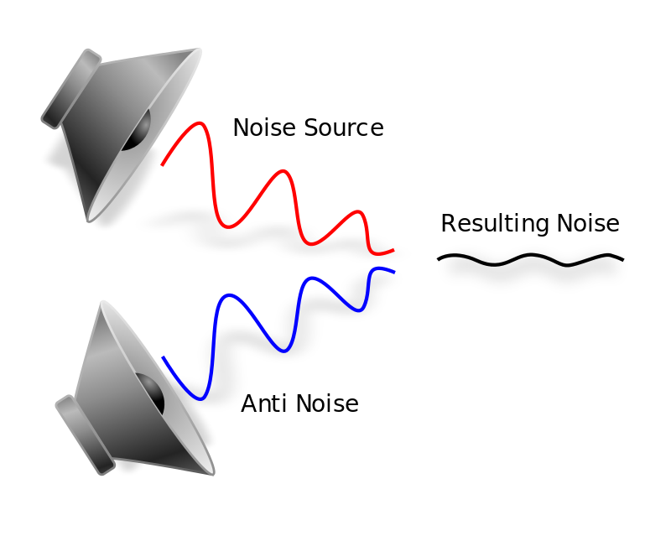
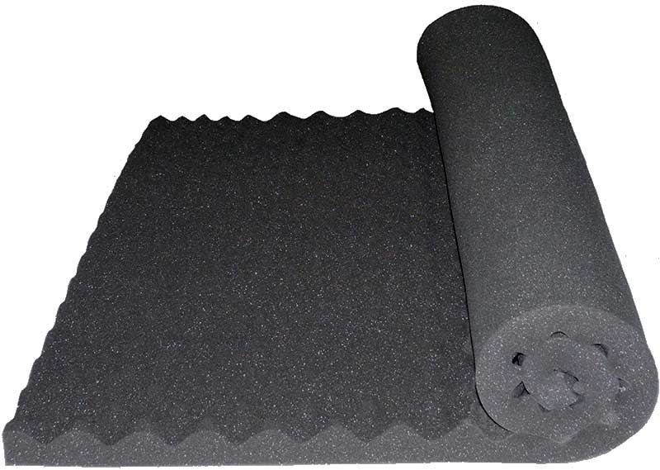
Noise Cancellation
Fig 1: Traditional Method of Noise Cancellation
(Sound absorbing materials)
Fig 2: Active Noise Cancellation

Slide 5
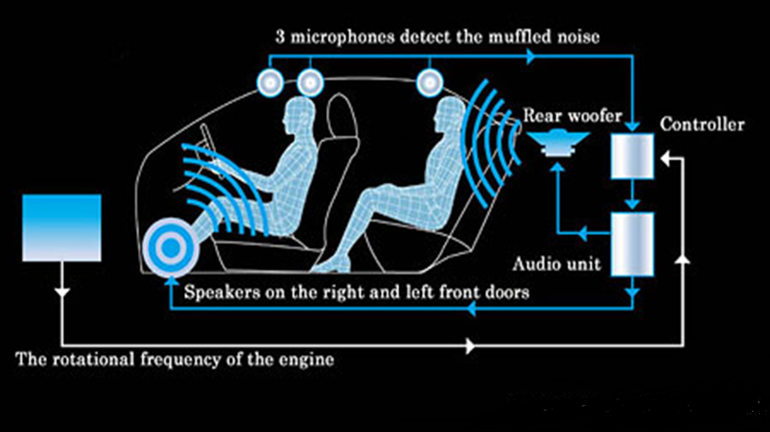
ANC terminology
Noise
Anti-noise
Noise Cancellation algorithms
Reference
Error

Slide 6
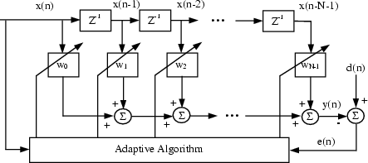
Adaptive Filters
Fig 3: Adaptive filters

Slide 7
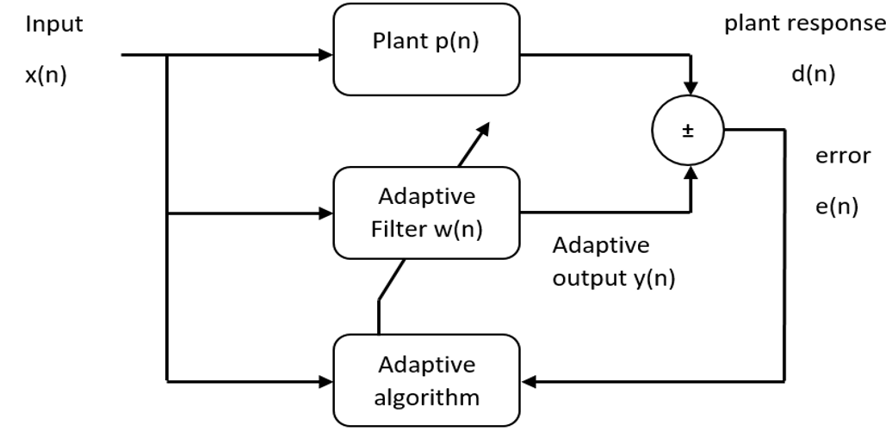
Secondary path calibration
Fig 4: Block diagram for system identification

Slide 8
Least Mean Square (LMS) algorithm
Realizes adaptive filter in such a way that mean square of the error signal is minimum
Cost function, J(n) = E( e² (n))
LMS algorithm updates the filter weights, based only on the error at current time
Weight update equation
w(n+1) = w(n) + µ . e(n) . x(n)

Slide 9
Recursive Least Square (RLS) algorithm
Realizes adaptive filter in such a way that weighted linear squares of the error signal is minimum.
Cost function, J(n) = ∑ λ^{n-i} e² (i)
Importance of λ: Filter is more sensitive to recent samples when λ is less.
Weight update equation
w(n+1) = w(n) + e . k

Slide 10
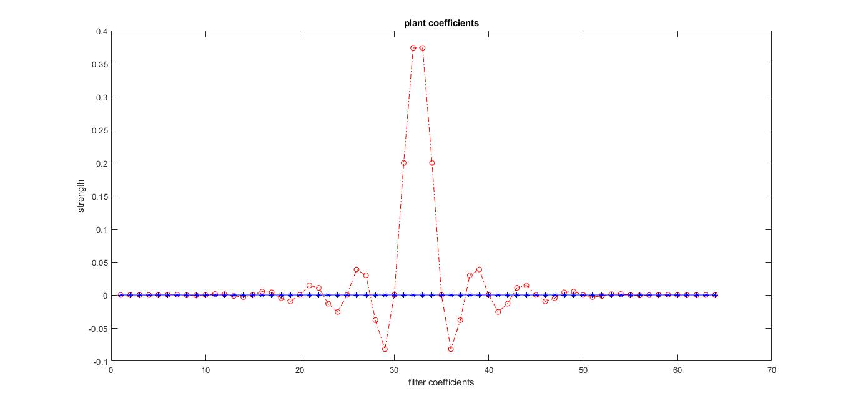
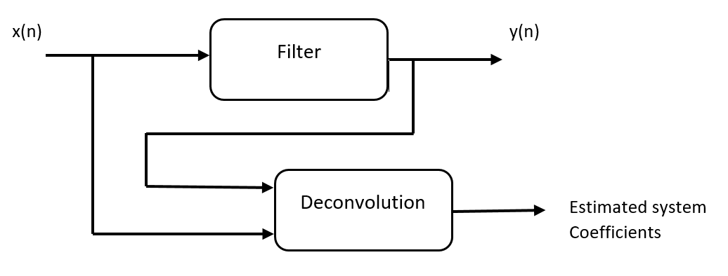
Results: System Identification using Deconvolution
Plant is chosen as a low pass filter of 64 coefficients
Fig 5: Block diagram of deconvolution
Fig 6: Comparison of filter coefficients
before training

Slide 11
Deconvolution Results
Length of input signal in samples | Filter order: 9 | Filter order: 99 | Filter order: 255
100 | Correct Identification of system | Incorrect Identification of system | Incorrect Identification of system
1000 | Correct Identification of system | Incorrect Identification of system | Incorrect Identification of system
10000 | Correct Identification of system | Incorrect Identification of system | Incorrect Identification of system
100000 | Correct Identification of system | Incorrect Identification of system | Incorrect Identification of system
Table 1: Results obtained by deconvolution process

Slide 12
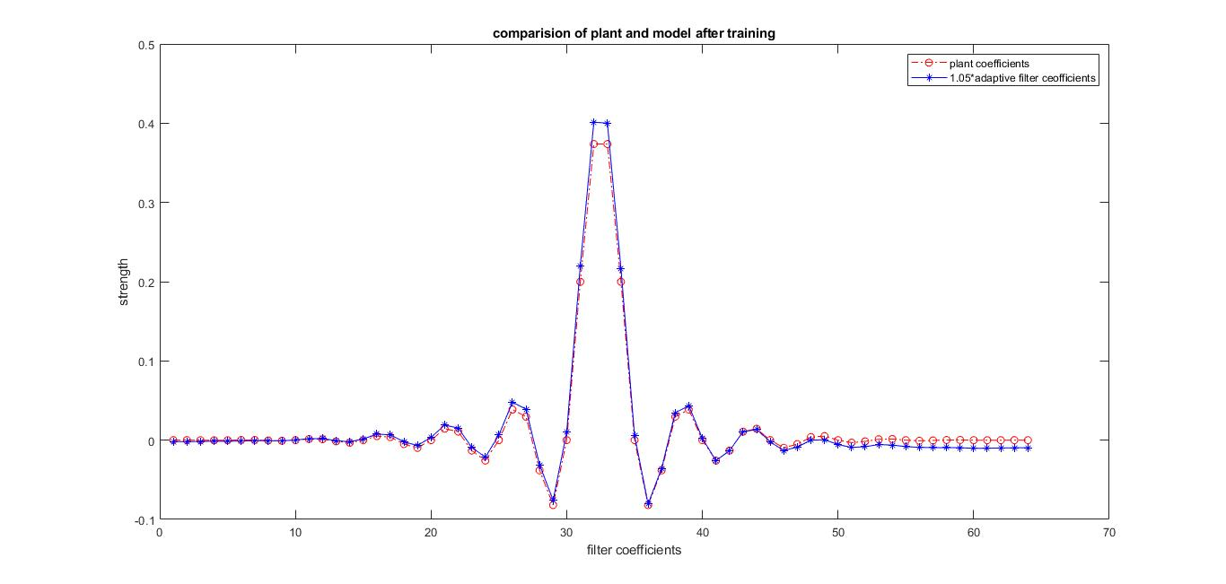
System Identification using adaptive algorithms
Fig 7 : Filter Coefficients before training
Fig 8: Filter Coefficients after training

Slide 13
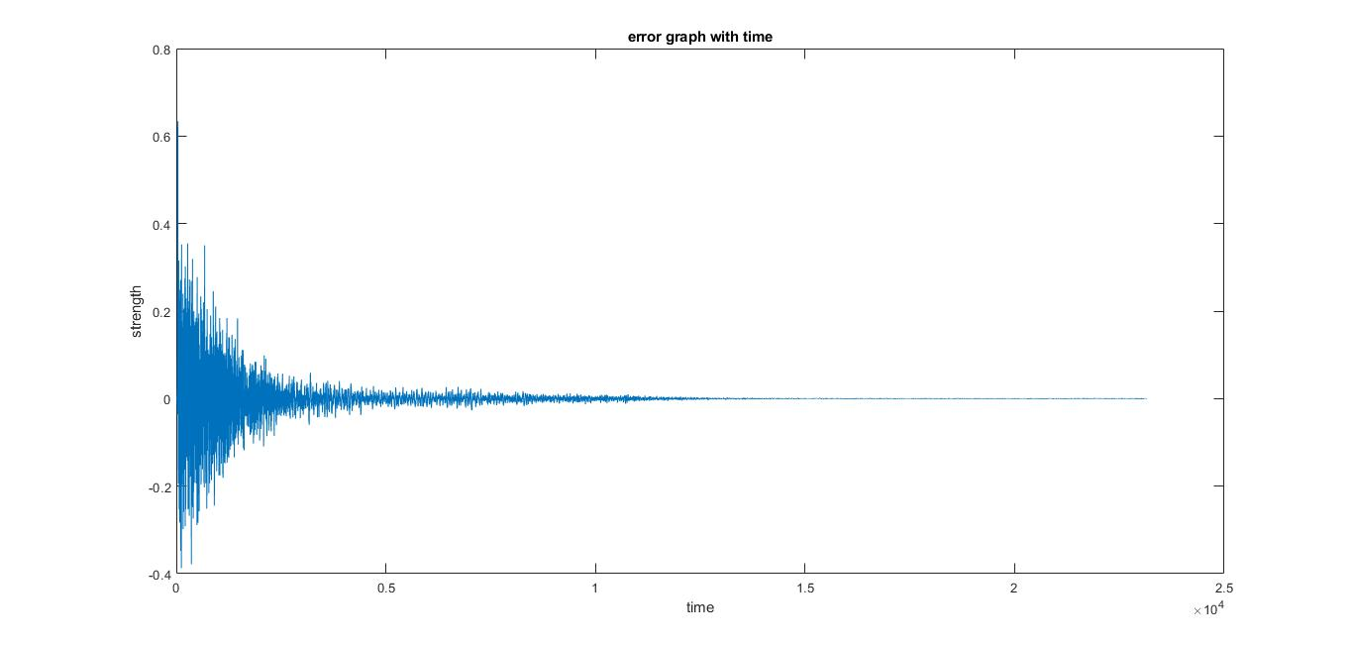
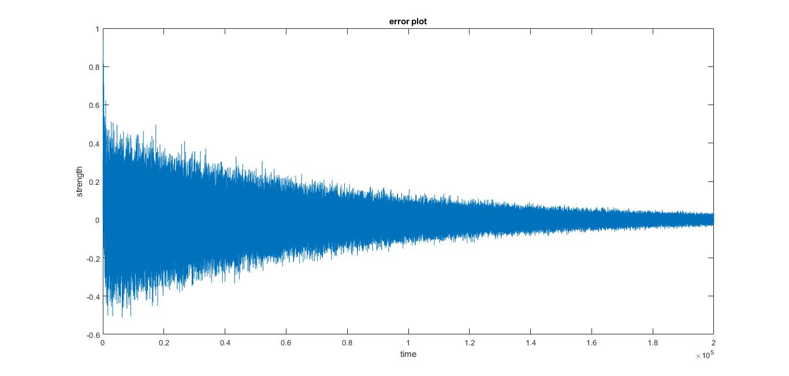
Error graphs
Fig 9: Error graph in sample based processing
Fig 10: Error graph in block based processing

Slide 14
System Identification using adaptive algorithms
Parameter | Sample based processing | Block based processing (block size: 64)
Length of input signal considered to identify system (in samples) | 6300 Samples | 638 blocks (almost 40000 samples)
Table 2: Comparison between Sample based processing and Block based processing

Slide 15
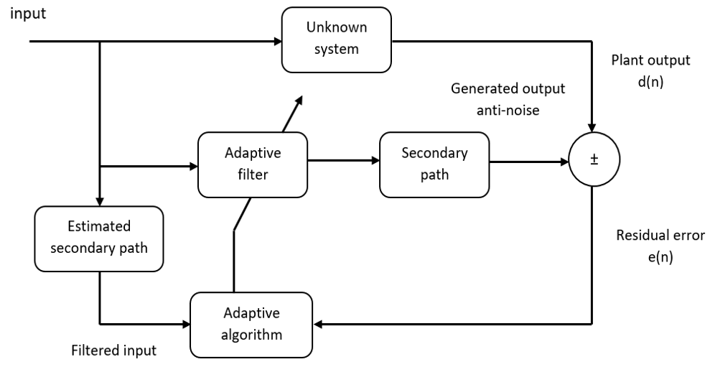
Active Noise Cancellation
Fig 11: Block diagram for Noise cancellation

Slide 16
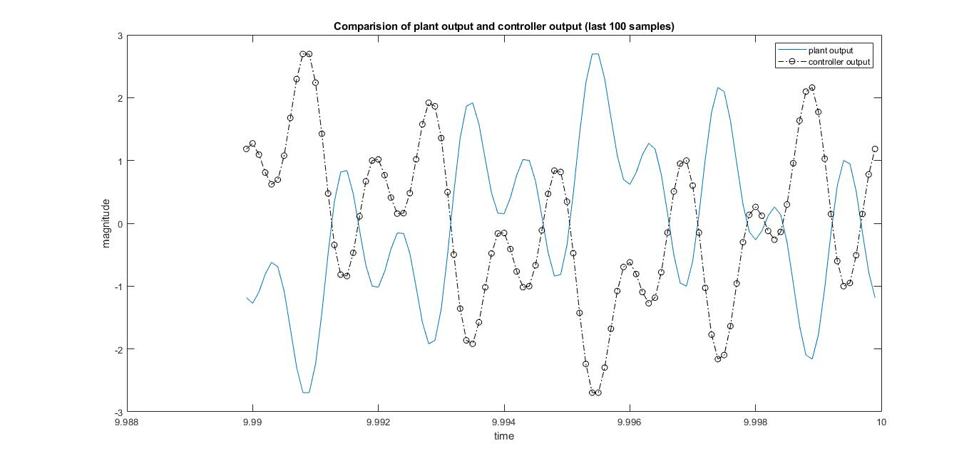
Comparison of Noise and anti noise: LMS and RLS
Fig 12: Comparison of plant output and controller output

Slide 17
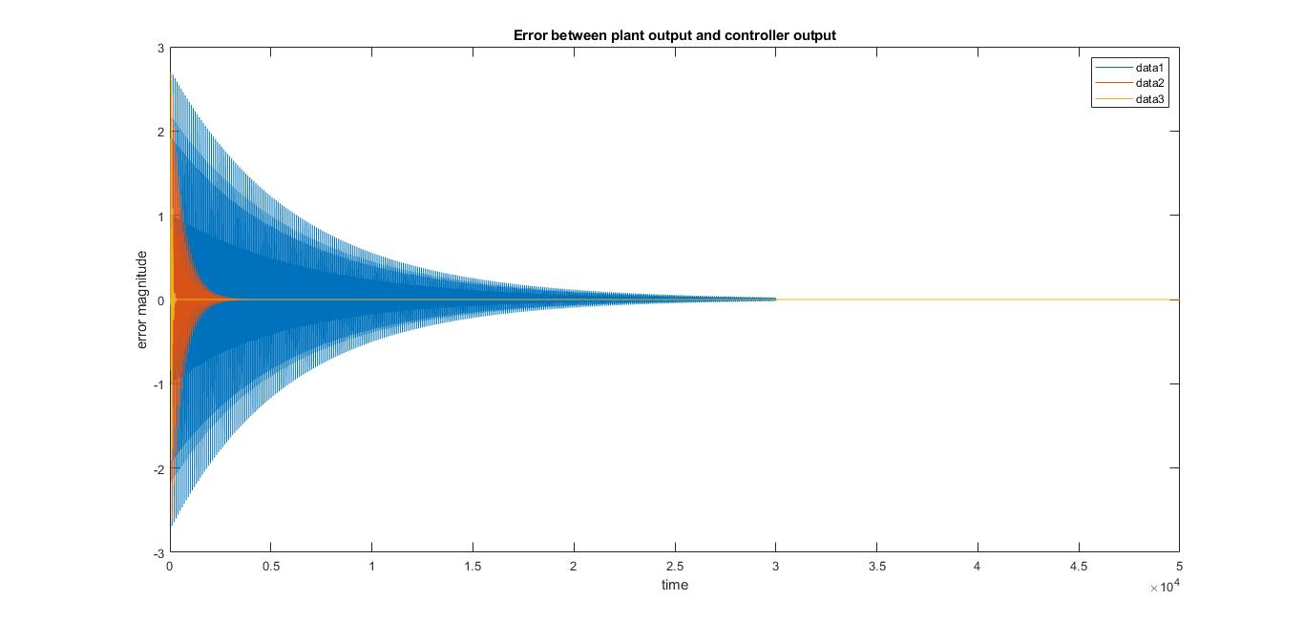
Error graph in ANC: LMS
Fig 13: Error graph in LMS for different convergence rates for filter tap length of 64

Slide 18
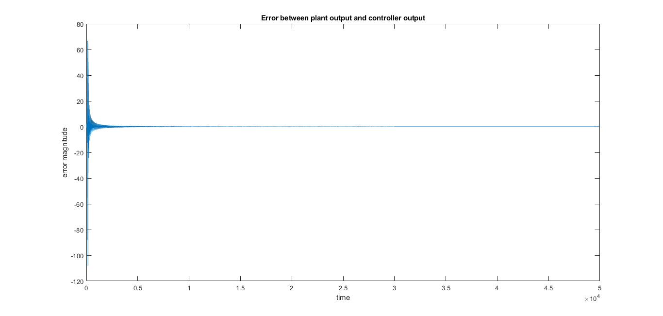
Error graph in ANC: RLS
Fig 14: Error graph in RLS

Slide 19
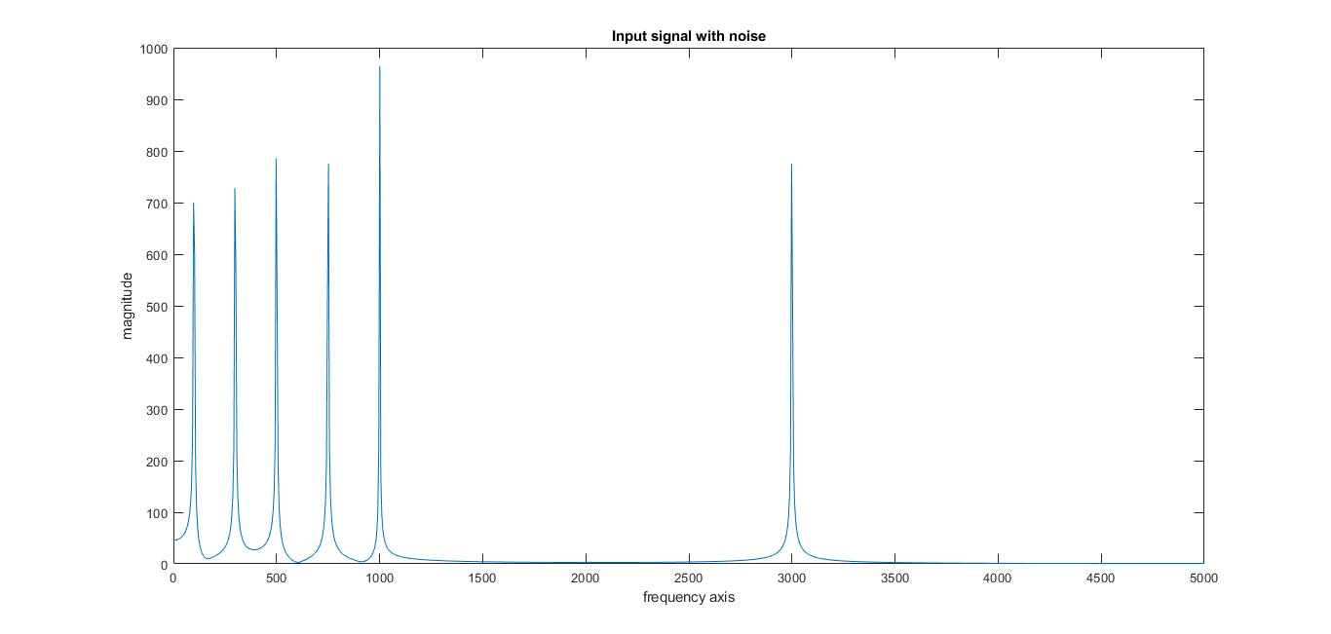
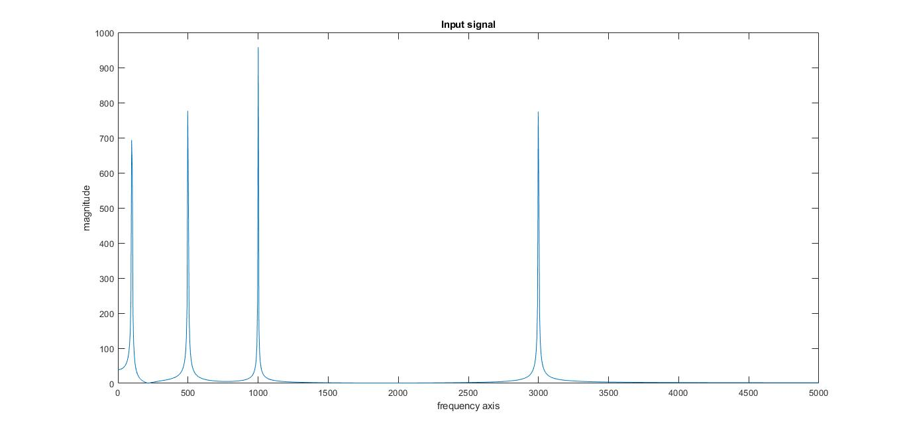
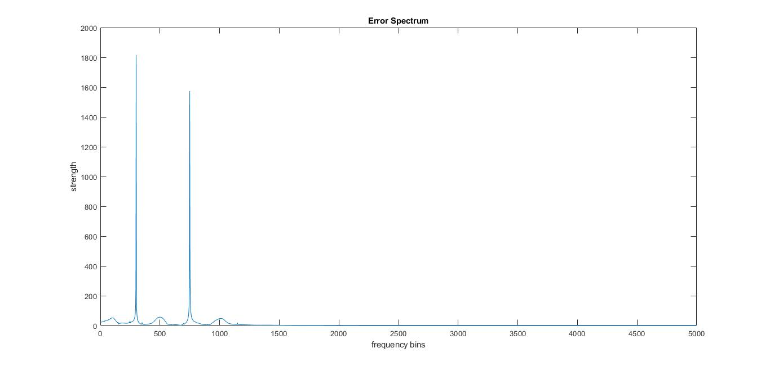
Proof that ANC cancels only Noise, even though it gets interfered with some other periodic signals
Fig 15: Input to the Plant : 100Hz, 300Hz, 500 Hz, 750 Hz, 1000 Hz, 3000 Hz
Fig 16: Input to the ANC System : 100Hz, 500 Hz, 1000 Hz, 3000 Hz
Fig 17: Error spectrum indicating that 300 Hz and 750 Hz remain un-cancelled

Slide 20
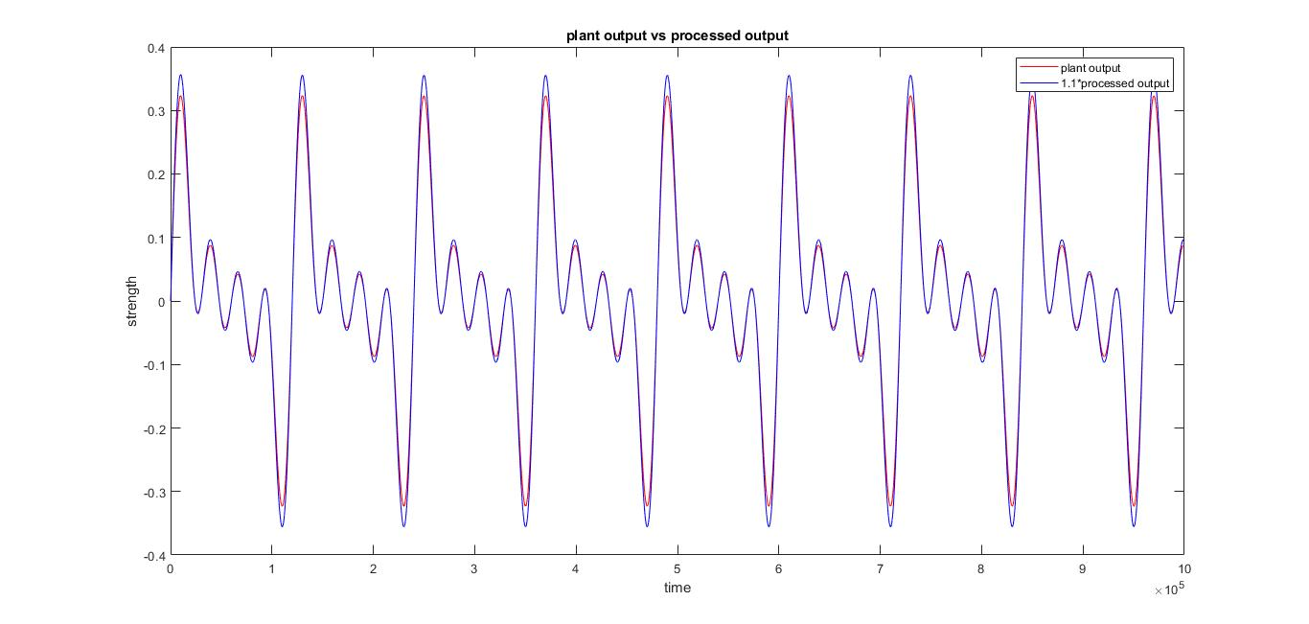
Narrowband Method of Noise Cancellation
Parameters chosen:
Sampling frequency, fs= 2000
Fundamental frequency = 2*pi*(rpm/60)/fs
Harmonics considered: 2, 4 , 6 and 8
Fig 18: Comparison of plant output and controller output

Slide 21
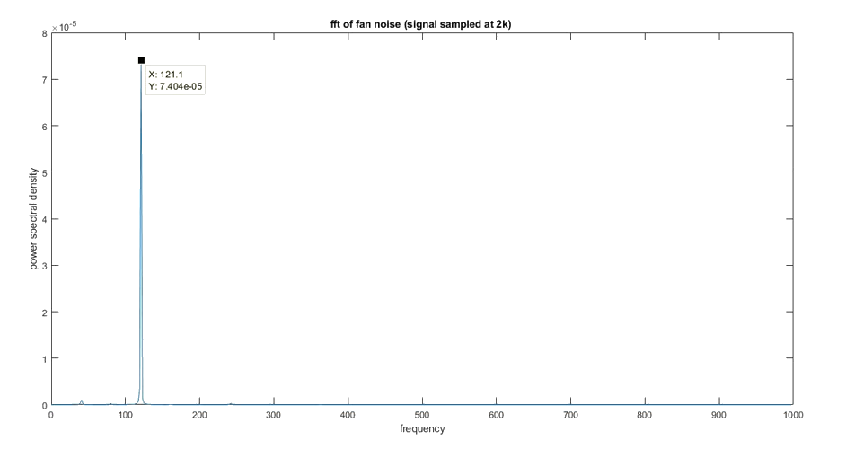
Active Noise Cancellation for fan noise by using LMS and RLS
Parameter Chosen
Sampling frequency: 2000 Hz
Fig 19: Frequency domain representation
of fan noise

Slide 22
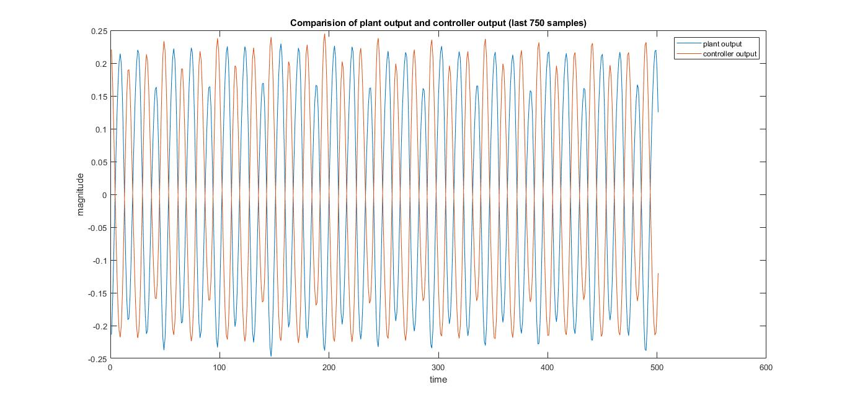
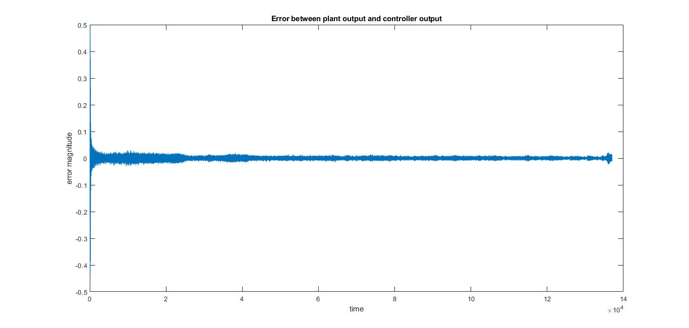
Fig 22: Comparison of outputs
Fig 21: Error signal (Narrowband case)

Slide 23
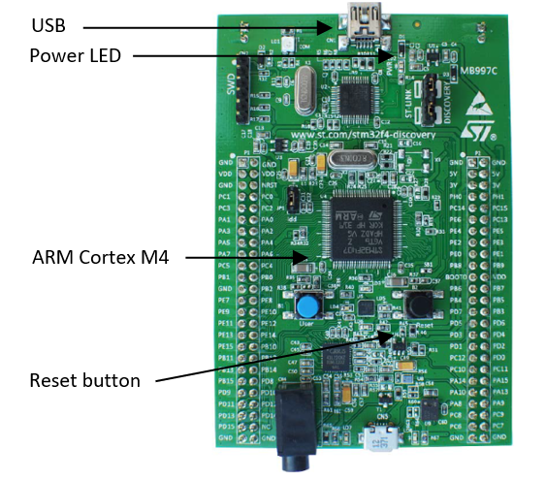
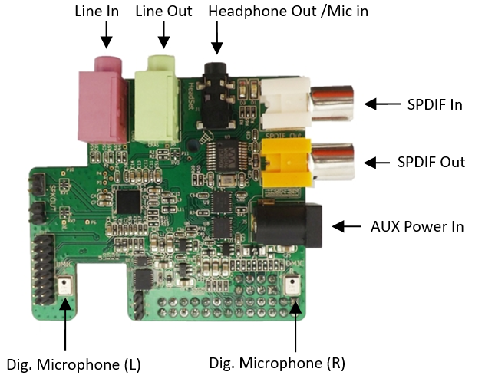
Hardware Platform
Fig 23: STM32F407 board
Fig 24: Wolfson pi audio card

Slide 24
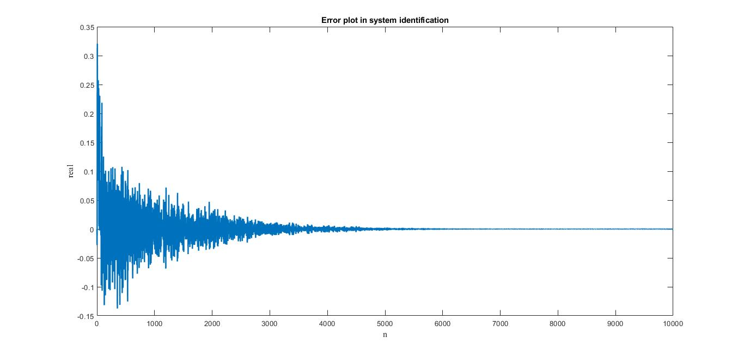
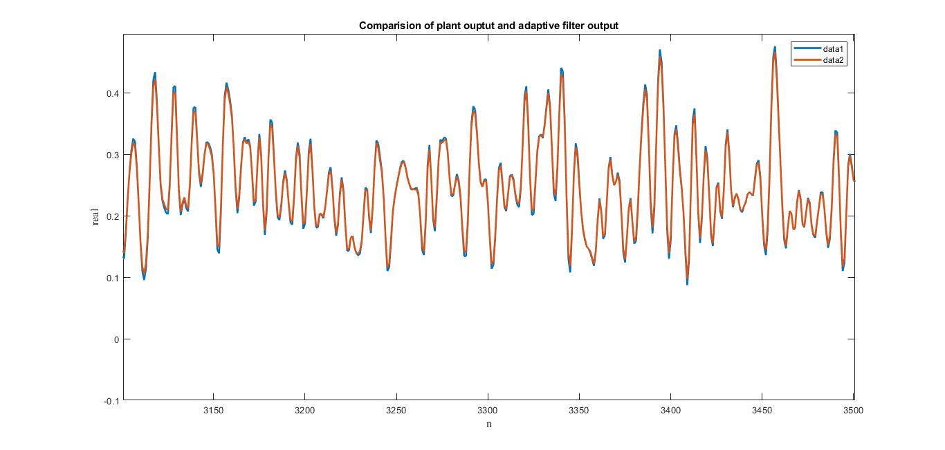
Results: Keil platform
Fig 25: Error graph in LMS algorithm
for filter order of 9
Fig 26: Comparison of outputs
for filter order of 9

Slide 25
Conclusions
We observed that sample based processing works fast than block based processing while identifying an unknown system.
2. Considering different parameters like convergence time and error, we observed that Recursive Least square algorithm works better than Least Mean Square algorithm.
3. At software level, adaptive algorithms are accurately generating anti-noise wave forms.

Slide 26
Future work
1. Test the performance of NLMS and RLS with engine noise recordings that are non-stationary.
2. Identify the limitation of these algorithms, with respect to, how rapidly they can track changes in the noise.
3. Understand the implementation of these algorithms on DSP platform.

Slide 27


Slide 28
Back up slides

Slide 29
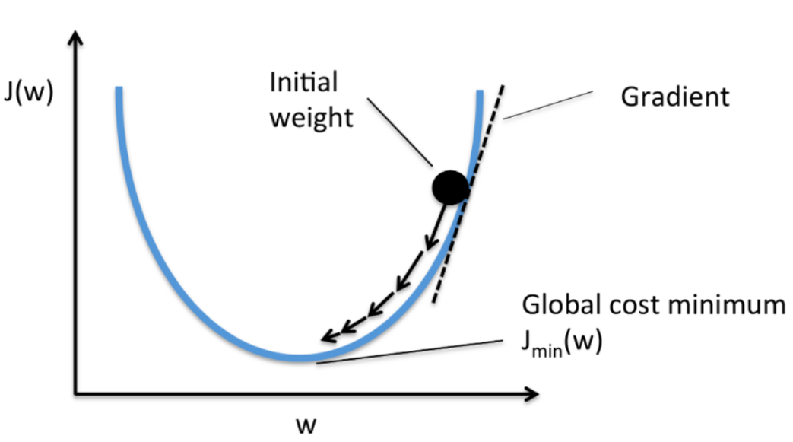
Cost functions and Gradient Descent
Cost function helps the algorithm to change its behavior to minimize mistakes.
Gradient descent enables a model to learn the gradient or direction that the model should take in order to reduce errors.
Fig 5: Gradient Descent Technique

Slide 30
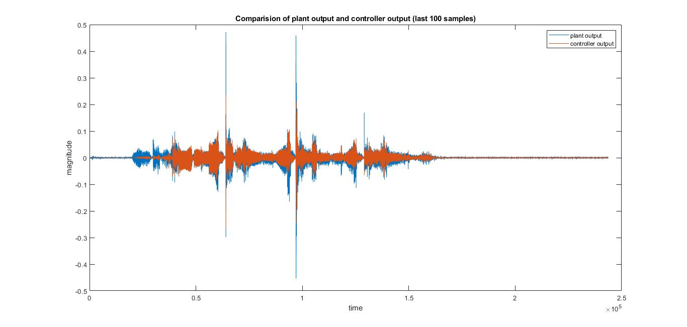
Non periodic signal: Human Voice
Fig 27: LMS algorithm applied to Human voice

Slide 31
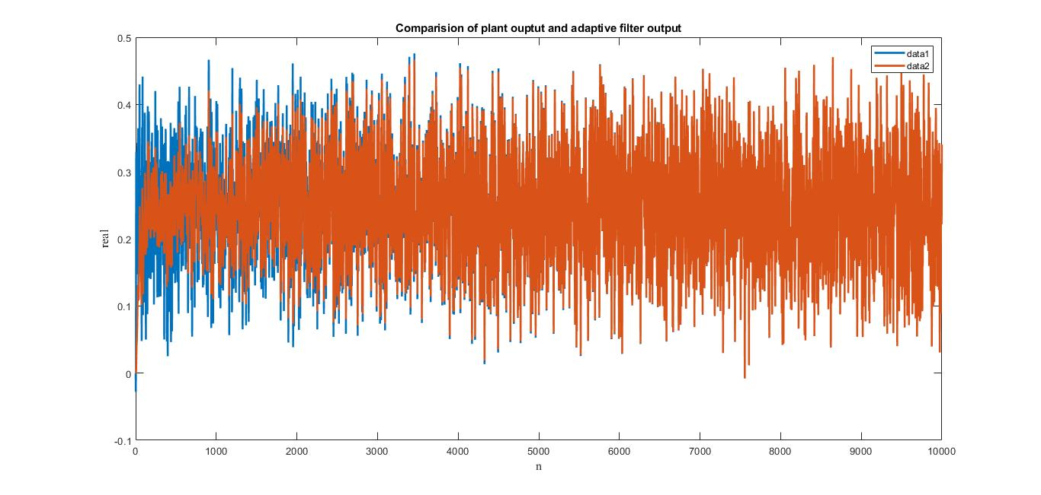
Comparison of outputs (full version)
Fig 28: Comparison of outputs (full version)

Slide 32

Fan noise + Human speech
There are three parts in the audio
Input to plant: Fan noise + human speech
Input to controller unit: Fan noise
Resulting error signal

Slide 33
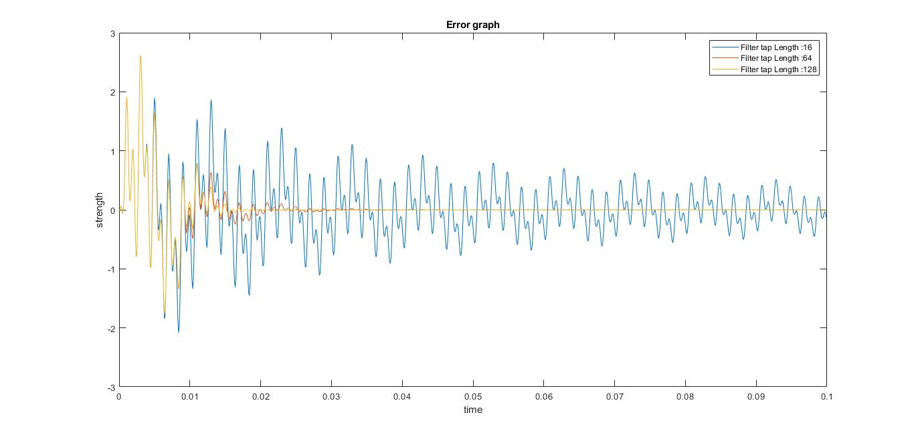
Error graph in ANC for different filter weights: LMS
Fig 18: Error graph in LMS for different filter weights

Slide 34
Parameters considered for Noise Cancellation
Input : 100 Hz, 500 Hz, 1000 Hz, 3000 Hz
Sampling rate chosen : 10000 Samples/sec
Total length of the input : 100000 samples
Plant cut off frequency : 2500Hz(end of passband)
Secondary path filter cut off frequency : 2000 Hz(end of passband)

Slide 35
System Identification using adaptive algorithms
Parameter | Sample based processing |  | Block based processing
 | Deterministic input | Random data as input(white noise) | Deterministic Input | Random data as input
Time taken to converge plant(with tolerable error of 0.01) | 0.01 sec | 0.03 sec | 0.06 sec | 0.14 sec
Length of input considered to converge to plant | 1400 samples | 6300 samples | 237 blocks*64 samples/block (almost 16000 samples) | 615 blocks*64 samples/block (almost 40000 samples)

